Slide 1
Session #15: Self-Supervised Coding Models
Tuesday, October 18
CSCI 601.771: Self-supervised Statistical Models

Slide 2

https://github.caom/features/copilot

Slide 3
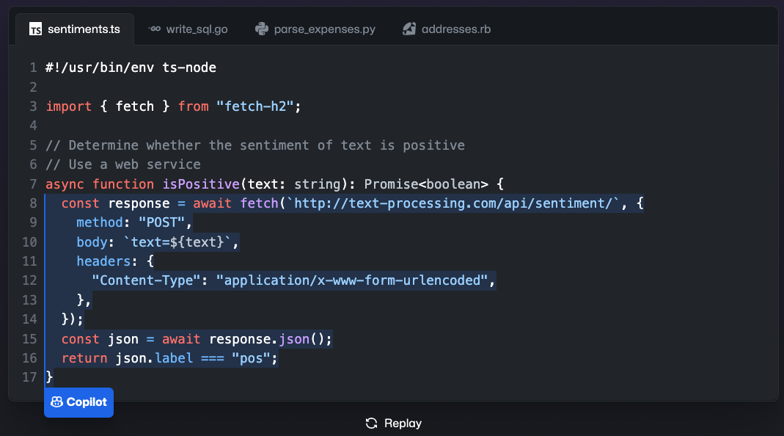
https://github.caom/features/copilot

Slide 4
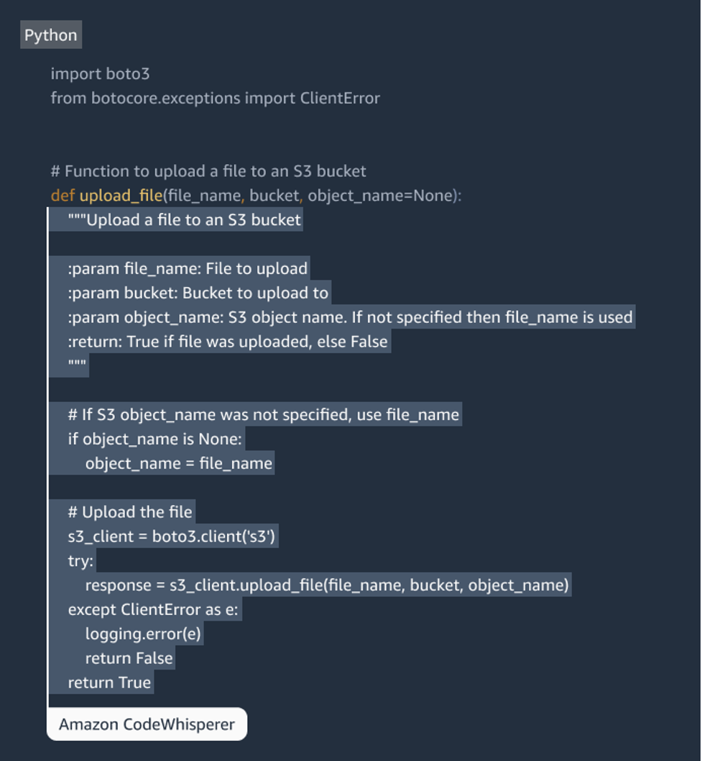

https://aws.amazon.com/codewhisperer/

Slide 5

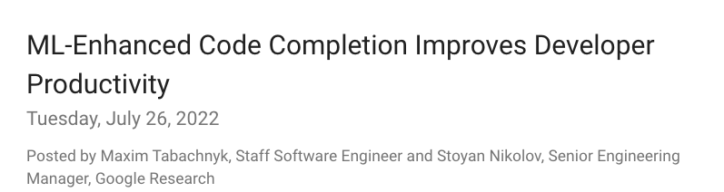

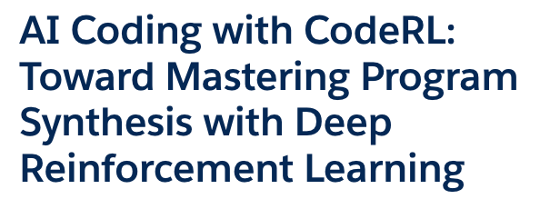

Slide 6
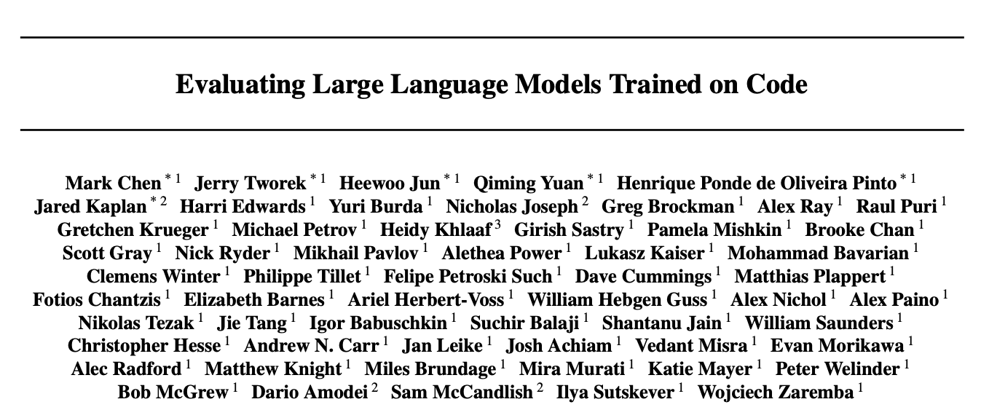
Ayo, Fadil, Yongrui
Stakeholders 😭

Slide 7
Introduction
Large language models: powerful!
GPT3
Could generate simple programs from Python docstrings
Exciting: not explicitly trained on code generation
➡ hypothesis: a specialized GPT would excel at coding tasks ➡ Codex
Method: inspired by real-world programming
Real-word: iterations, bug fixes
Approximation: generating many samples from our model, select one that passes all unit tests
Further evaluation: what if only one sample is generated?

Slide 8
Models & GPT
GPT: Baseline to compare with Codex
GPT-12B: solve no problems when single sample generated
GPT-J: solve 11.4% of problems
Codex = GPT + fine-tuning
Solve 28.8% of problems with single sample generated
Codex-S = Codex + supervised fined-tuning
Solve 77.5% of problems with at least one correct solution
Solve 37.7% of problems with single sample generated
Codex-D: generate docstrings from code

Slide 9
Codex-S
Motivation: some code unrelated to synthesizing functions from docstrings
Supervised fine-tuned on correctly implemented standalone functions
Data collected from
Competitive programming website
problem statements ➡ docstrings
example unit tests
Repositories with continuous integration
input/output for functions ➡ unit tests
no need to know algorithms and data structures
complement the puzzle nature of coding competition
broaden the distribution of tasks

Slide 10
Codex-D
Motivation: describe the intent behind generated code
But not easy
Leave out important details
Over conditioned on the function name
Developers devote less time to writing docstrings

Slide 11
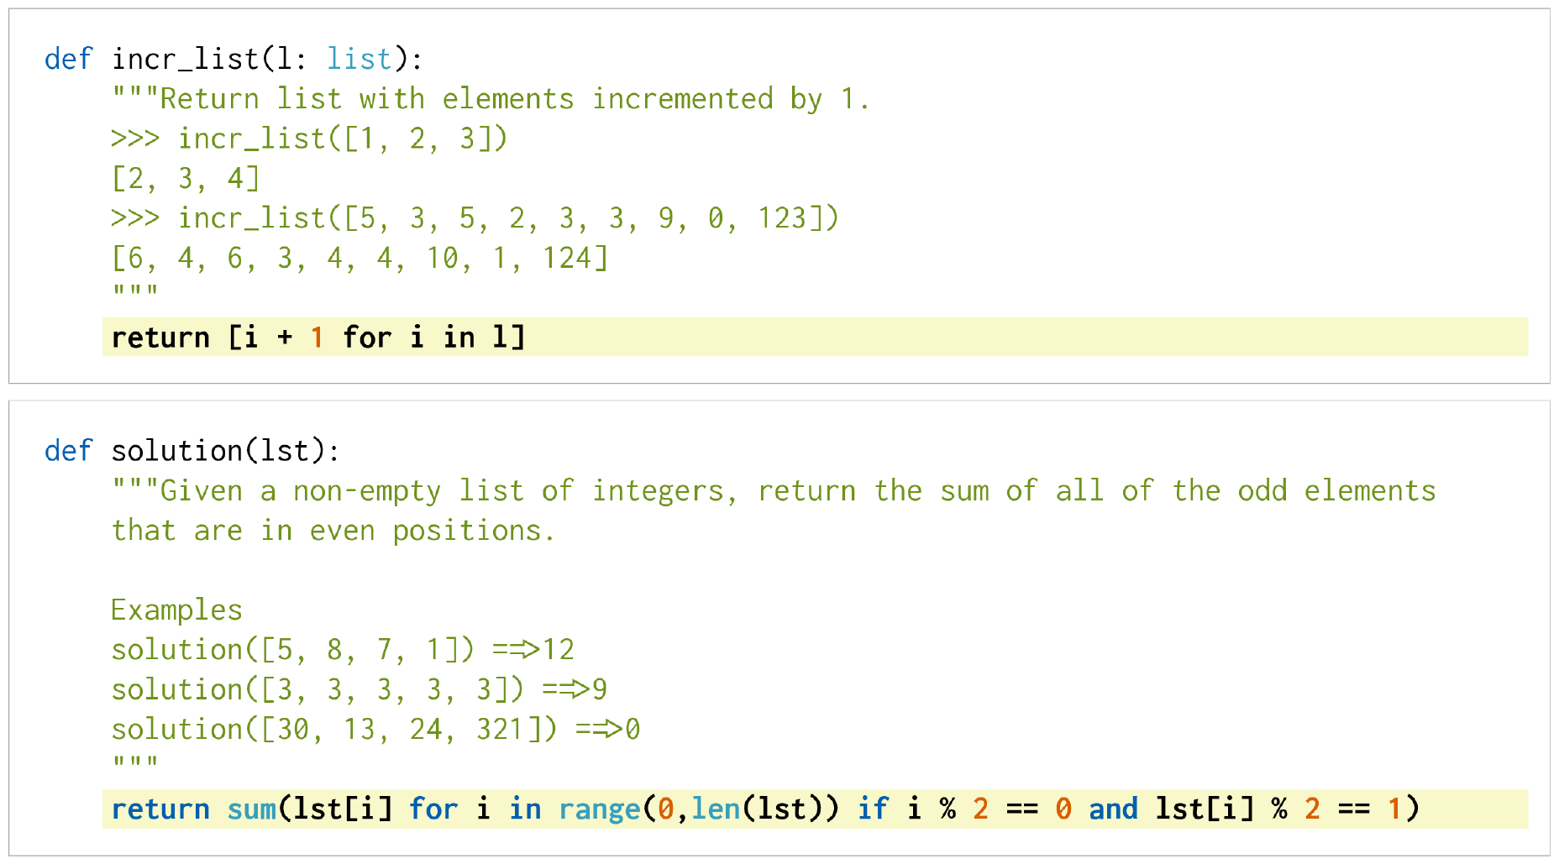
Samples
prompts
Generated sample
prompts
Generated sample

Slide 12
Evaluation
Pass@k evaluates
Functional correctness
k: Number of code samples generated per problem
Pass: Any sample that passes the unit tests.
Total fraction of problems solved is reported.
Downside: Causes high variance

Slide 13
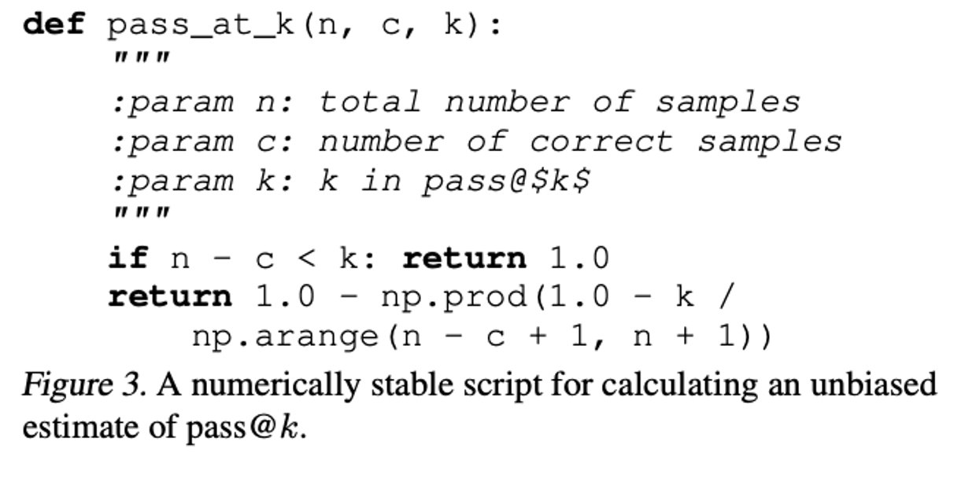
Evaluation
Pass@k evaluates
Functional correctness
k: Number of code samples generated per problem
Pass: Any sample that passes the unit tests.
Total fraction of problems solved is reported.
Downside: Causes high variance
Let's reduce variance:
Generate n >= k samples per task
n= 200
k<= 100
c: Count the number of correct samples, c <= n
Calculate unbiased estimator

Slide 14
Evaluation Metric
BLEU Score vs. Pass @ k
Match based metric vs Function based metric
Sequential vs Tree structure
Ambiguity in NLP vs Unique semantics in Code
BLEU score has problems getting semantics that are code-specific

Slide 15
Evaluation Metric
BLEU Score vs. Pass @ k
Match based metric vs Function based metric
Sequential vs Tree structure
Ambiguity in NLP vs Unique semantics in Code
BLEU score has problems getting semantics that are code-specific
Conclusion: BLEU score may not indicate improved rates of functional correctness in practice.

Slide 16
Datasets
HumanEval
Dataset of 164 handwritten programming problems
Each problem includes a
Function signature
Docstring
Body
Unit tests, 7.7 tests per problem
Programming tasks in the HumanEval dataset assess
Language comprehension
Reasoning
Algorithms
Simple mathematics.

Slide 17
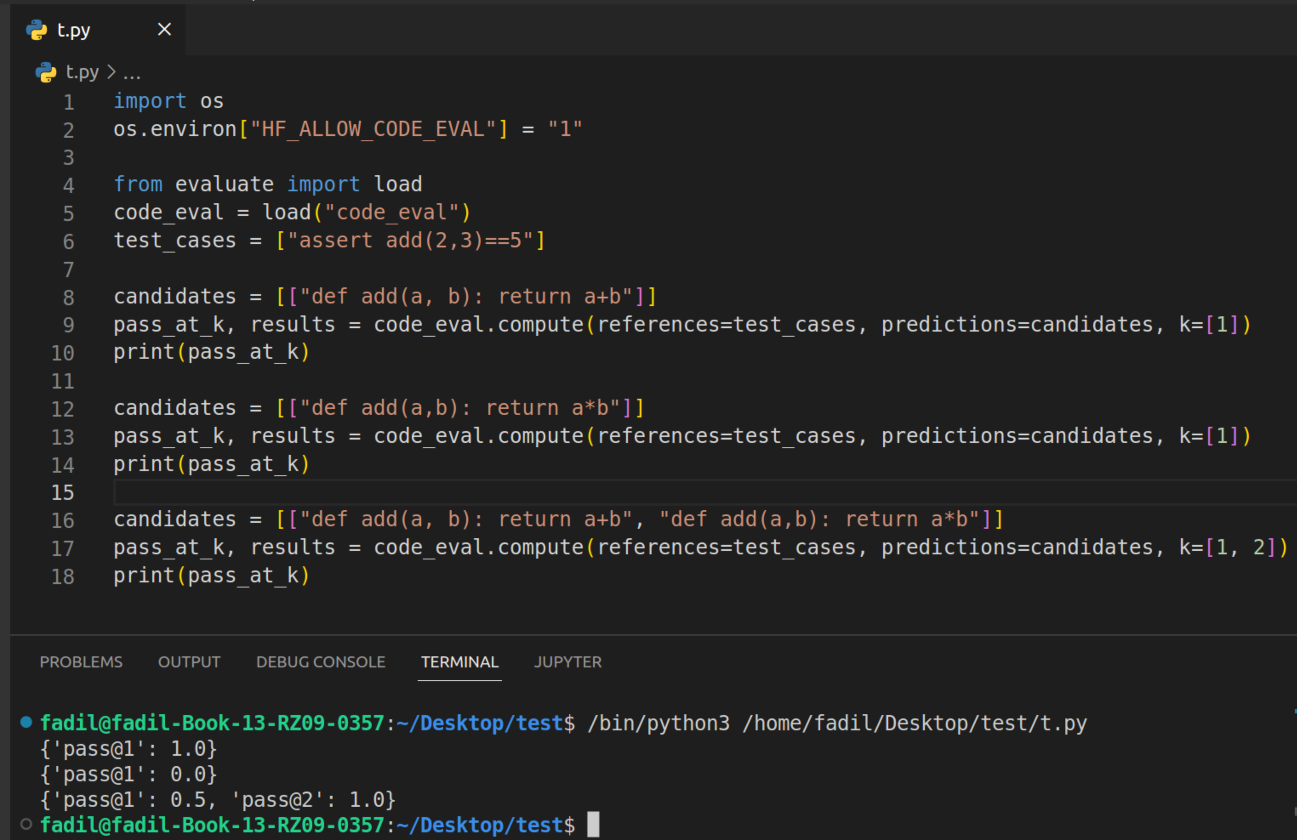
pass@k in practice

Slide 18
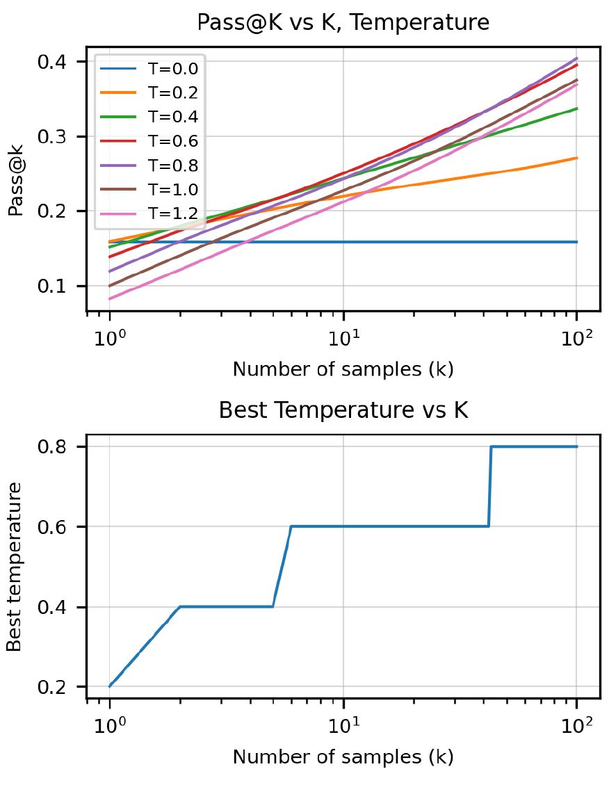
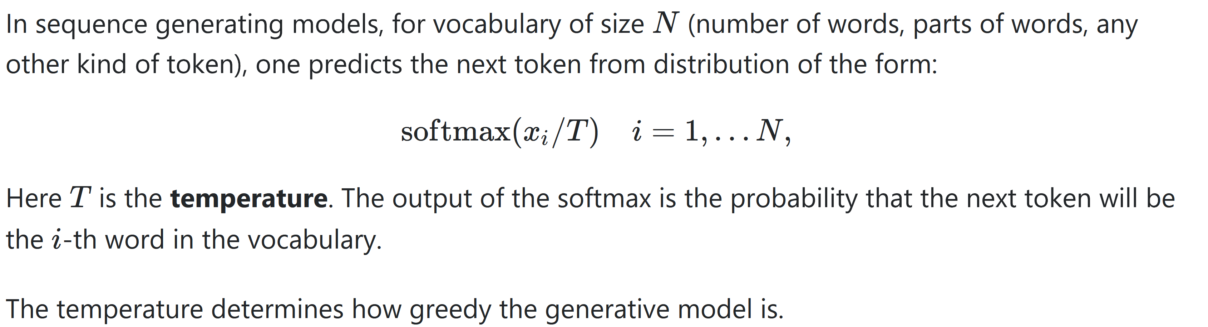
Results: Temp vs k

Slide 19
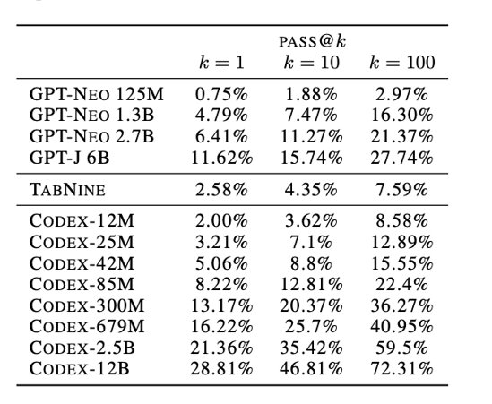
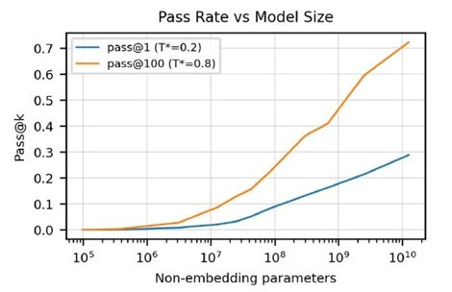
Codex and Codex-S Comparison on HumanEval

Slide 20
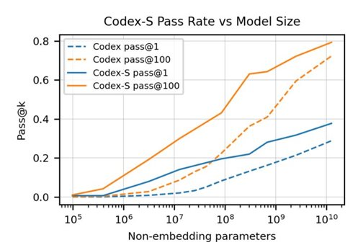
Codex and Codex-S Comparison on HumanEval

Slide 21
Datasets
APPS
APPS dataset was used to measure the coding challenge competence of language models.
Collected from open source materials
10,000 coding problems
5000 training problems
Each with a set of unit tests and, for the training data, a set of correct solutions.
5000 testing problems
Each with a set of unit tests and, for the training data, a set of correct solutions.

Slide 22
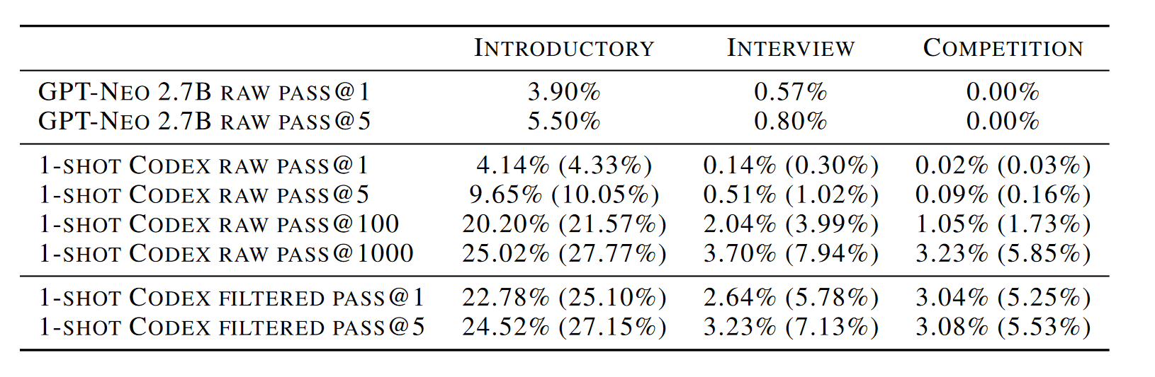
APPS Results

Slide 23
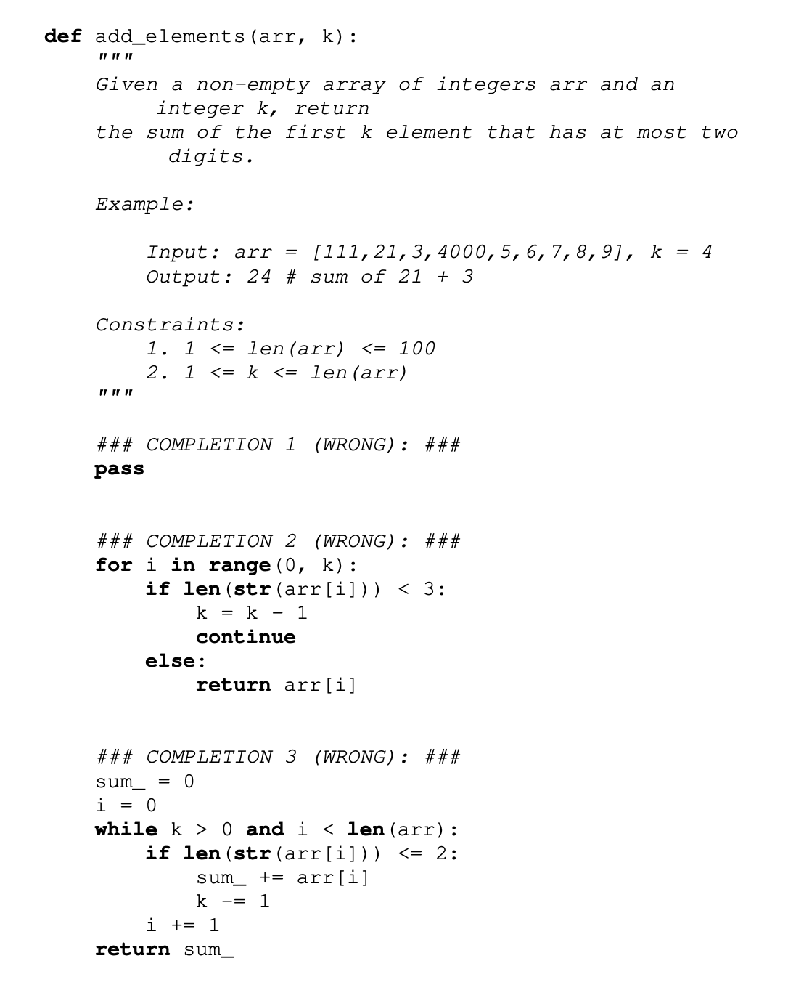
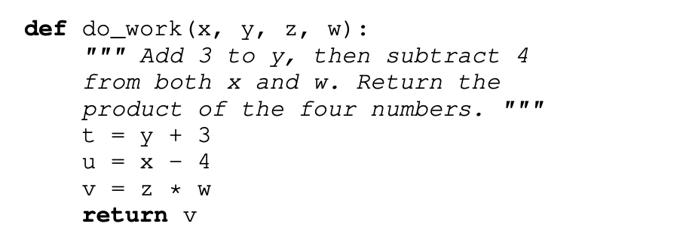
Limitations
Not sample efficient to train
Invoke undefined/out-of-scope functions, variables
Performance degradation as docstring length increases
Have difficulty with binding operations to variables

Slide 24
Thank You!

Slide 25
Empiricist
Examples from CoPilot (https://github.com/features/copilot).
Examples from a public model, CodeGen.
Examples from GTP-2 (https://beta.openai.com/playground).
Test and evaluation of the codes generated by GPT-2
(https://colab.research.google.com/drive/1R6rWcqseTKGWglBiPyIIutwBx4xEQuCl#scrollTo=hiNfrqWr8Vl1)
👩🏽‍🔬: Empiricist: Tianqi Shang & Haoyue Guan😭

